Slide 1
Topics will Be Covered:
Waveforms
Generation of Sine Waveform
Definitions Related to Waveforms
General Format of Mathematical Equation for the Sinusoidal Voltage/Current with Zero Degree Initial Angle
General Format of Mathematical Equation for the Sinusoidal Voltage/Current with Phase Angle
Phase Difference and Phase Relation Between Two Waveforms

Slide 2
Chapter 13
Sinusoidal Alternating Waveforms

Slide 3
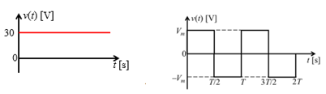
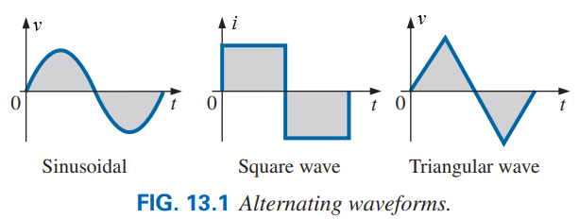
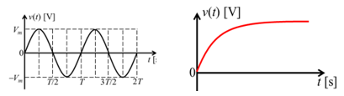
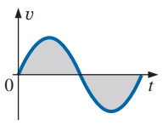
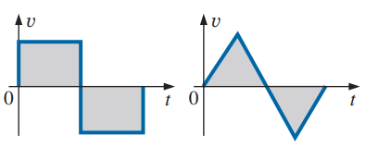
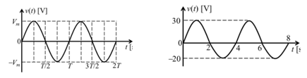
Waveforms
Waveform: The path traced by a quantity, such as the voltage, current etc. as a function of some variable such as time (as above), position, degrees, radians, temperature, and so on.
(2) Waveform Based on Direction of Propagation
Unidirectional
Bidirectional
(3) Waveform Based on Periodicity
(1) Waveform Based on the Following Sine Rule
Aperiodic
Periodic
(4) Waveform Based on the Shape
Sinusoidal
Non-sinusoidal
Symmetrical
Asymmetrical
3

Slide 4
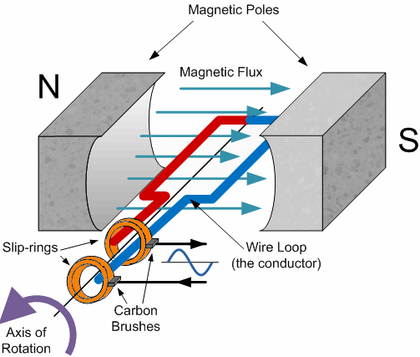
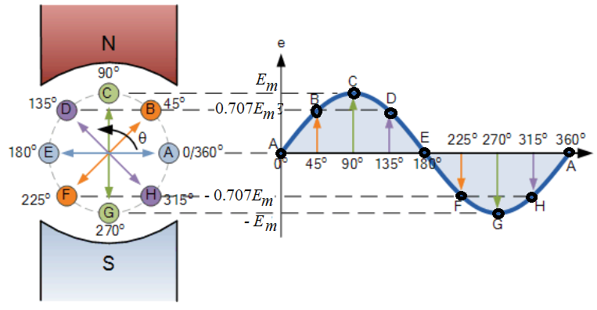
Generation of Sine Waveform
Faradays Law of Electromagnetic Induction:
Faradays First Law: Whenever a conductor is placed in a varying magnetic field an electromotive force (EMF) is induced or produced or developed across the conductor (called as induced emf), and if the conductor is a closed circuit, then induced current flows through it.
Faradays Second Law: The magnitude of induced emf is equal to the rate of change of flux linkages (dφ/dt) with the coil. So, induced emf: e = −N(dφ/dt) V.
(a) Simple construction of a generator
Magnitude of Induced voltage affected by flux density (B), the effective length of conductor (l), the conductor velocity (v) and sine of angle between flux line and the direction of motion of conductor.
e(t) = Blvsinα V = E_{m}sinα V
where, E_{m}=Blv is constant.
So, e(t) ∝ sinα V
(b) Generated waveform by a generator
The average value of AC quantity is zero.
4

Slide 5
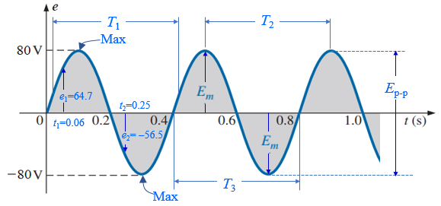
Some Definition Related to Waveforms
Instantaneous Value: The magnitude of a waveform at any instant of time is called instantaneous value.
Instantaneous value is denoted by lowercase letters [such as e for sources of voltage, v for the voltage drop across a load, i for the current pass through a load and p for the power]. In Fig. 13.3, e₁ = 64.7 V and e₂ = −56.5 V are instantaneous value of e at time t₁ = 0.06 s and t₂ = 0.25 s.
Fig. 13.3 Important parameters for a sinusoidal voltage.
Peak or Crest or Amplitude or Maximum Value: The maximum instantaneous value attained by an alternating quantity during positive and negative half-cycle is called its amplitude or peak or crest or maximum value.
Peak value is denoted by uppercase letters [such as E_{m}, V_{m} and I_{m}]. In Fig. 13.3, E_{m} = 80 V peak value of e.
Peak-to-Peak Value: The full voltage between positive and negative peaks of the waveform, that is, the difference between the positive peak and the negative peak.
Peak-to-Peak value is denoted by uppercase letters [such as E_{p-p}, V_{p-p} and I_{p-p}]. In Fig. 13.3, E_{p-p} = 80 V − (− 80 V) = 160 V peak-to-peak value of e.
5

Slide 6
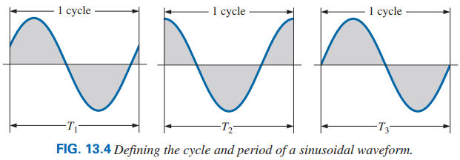
Periodic Waveform: A waveform that continually repeats itself after the same time interval. The waveform in Fig. 13.3 is a periodic waveform.
Cycle: The portion of a waveform that continually repeats itself after the same time interval is called a cycle.
The cycles within T₁, T₂, and T₃ in Fig. 13.3 may appear different in Fig. 13.4, but they are all bounded by one period of time and therefore satisfy the definition of a cycle.
Fig. 13.3 Important parameters for a sinusoidal voltage.
Period (T): The time taken by an alternating quantity to complete its one cycle is known as time period.
It is denoted by T seconds. After every seconds, the cycle of an alternating quantity repeats.
6

Slide 7


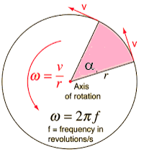
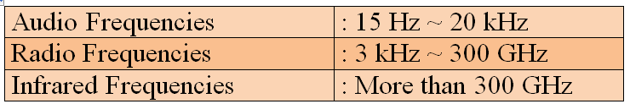
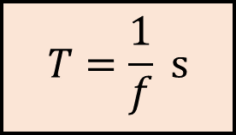
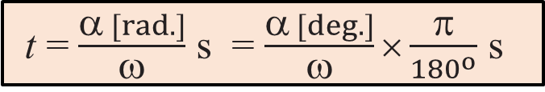
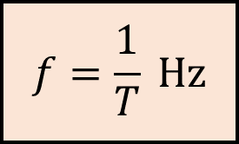

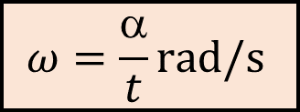
Frequency (f): The number of cycles completed by an alternating quantity per second is known as frequency.
It is denoted by f and it is measured in cycle/second which is known as Hertz, denoted by Hz.
Relation Between Degree and Radian:
In the world, some countries (Bangladesh, India, Argentina, Australia, Combodia etc.) use 50 Hz and some countries (USA, Canada, Brazil, Haiti, Eucador, Colombia, Costa Rica etc.) use 60 Hz as power frequency.
The frequency of DC voltage is zero (0) Hz.
Angular Frequency or Velocity (ω): The rate of change of angular position is called angular frequency or angular velocity. Unit of angular frequency is rad/s.
Relation between Frequency and Time Period: Frequency is reciprocal of time period.
$$ω=\frac{α}{t}\text{rad}\text{/}\text{s}$$
$$f=\frac{1}{T} \text{Hz}$$
$$T=\frac{1}{f} \text{s}$$
$$=ωt \text{[}\text{rad}\text{]}$$
t = $\frac{α [rad.]}{ω}$ s = $\frac{α [deg.]}{ω}×\frac{π}{{180}^{o}}$ s
7

Slide 8
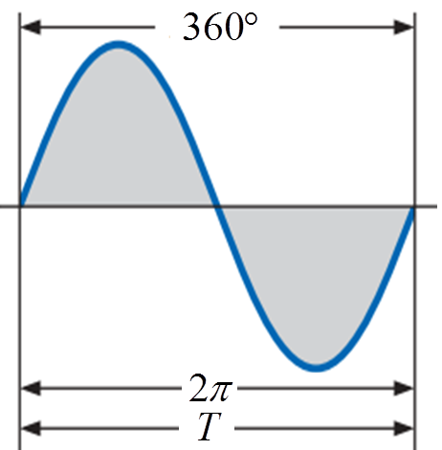
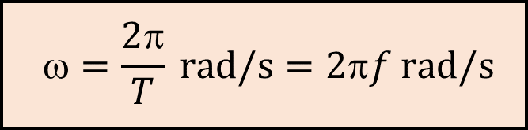
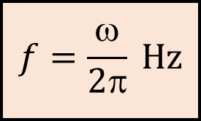
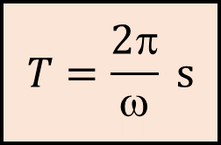
Relation among Angular Frequency, Frequency and Time Period:
$$=\frac{2π}{T} \text{rad}\text{/}\text{s}=2πf \text{rad}\text{/}\text{s}$$
$$T=\frac{2π}{ω} \text{s}$$
$$f=\frac{ω}{2π} \text{Hz}$$
Alternating Current/Voltage:
Alternating current/voltage rises from zero to a maximum value in one direction and decreases back to zero. It then rises to the same maximum value in the opposite direction and again decreases to zero. These values are repeated again and again at equal intervals of time.
The average value of AC quantity is zero.
It is seen from the following figure that the abscissa (x-axis) of alternating voltage and current can be represent in terms of time (t), angle (α) in deg., or angle (α) in rad.
8

Slide 9


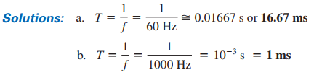

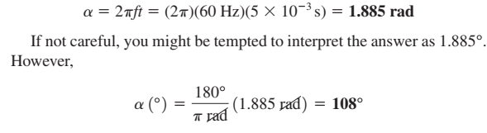



Solution: We know that, α = ωt, thus $t=\frac{α}{ω}$ s
However α must be converted to rad., since is ω rad/s.
$ [rad.]$ = $\frac{π}{{180}^{o}} ×{90}^{o}$ s = 1.57 rad
Solution: We know that, α = ωt or
EXAMPLE 13.5 Determine the frequency and period of the sine wave having an angular frequency of 500 rad/s.
Practice Problem 4 ~ 16 [P582]
9

Slide 10
General Format of Mathematical Equation for the Sinusoidal Voltage or Current with Zero Degree Initial Angle
10

Slide 11
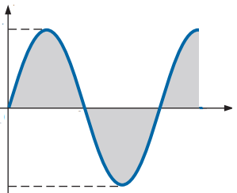

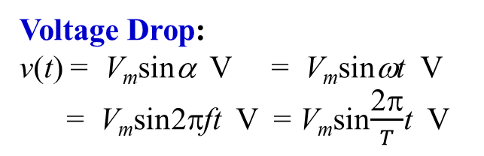

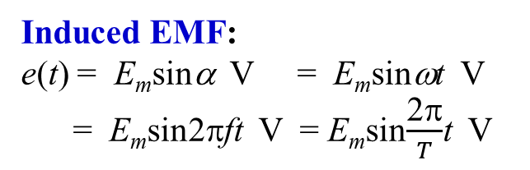

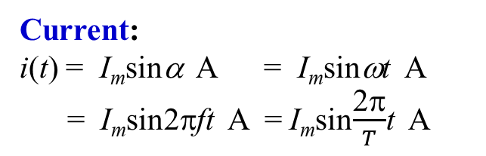
General Format of Mathematical Equation for the Sinusoidal Voltage or Current
Induced EMF:
e(t) = E_{m}sinα V = E_{m}sinωt V
= E_{m}sin2πft V = E_{m}sin$\frac{\text{2π}}{T}$t V
Voltage Drop:
v(t) = V_{m}sinα V = V_{m}sinωt V
= V_{m}sin2πft V = V_{m}sin$\frac{\text{2π}}{T}$t V
Current:
i(t) = I_{m}sinα A = I_{m}sinωt A
= I_{m}sin2πft A = I_{m}sin$\frac{\text{2π}}{T}$t A
Example: e(t) = 20sin31.4t mV
Example: v(t) = 60sin100πt V
Example: i(t) = 10sin261.67t μA
E_{m} = 20 mV; ω = 31.4 rad/s
V_{m} = 60 V; ω = 100π rad/s
I_{m} = 10 μA; ω = 261.67 rad/s
f = (31.4 rad/s)/2π = 5 Hz
f = (100π rad/s)/2π = 50 Hz
f = (261.67 rad/s)/2π = 41.67 Hz
T = 1/(5 Hz) = 0.2 s
T = 1/(50 Hz) = 0.02 s or 20 ms
T = 1/(41.67 Hz) = 24 ms
e(t) [mV]
$$=\sin^{−1}\left[\frac{e(t)}{Em}\right]$$
v(t) [V]
$$=\sin^{−1}\left[\frac{v(t)}{Vm}\right]$$
i(t) [μA]
$$=\sin^{−1}\left[\frac{i(t)}{Im}\right]$$
20
60
10
π/2 π 3π/2 2π 5π/2 α [rad.]
π/2 π 3π/2 2π 5π/2 α [rad.]
π/2 π 3π/2 2π 5π/2 α [rad.]
0 90º 180º 270º 360º 450º α [deg.]
0 90º 180º 270º 360º 450º α [deg.]
0 90º 180º 270º 360º 450º α [deg.]
−20
−60
−10
e(t) [mV]
v(t) [V]
it) [μA]
20
60
10
0 0.05 0.1 0.15 0.2 0.25 t [s]
0 5 10 15 20 25 t [ms]
0 6 12 18 24 30 t [ms]
−20
−60
−10
11

Slide 12
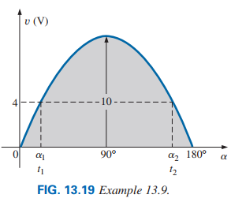
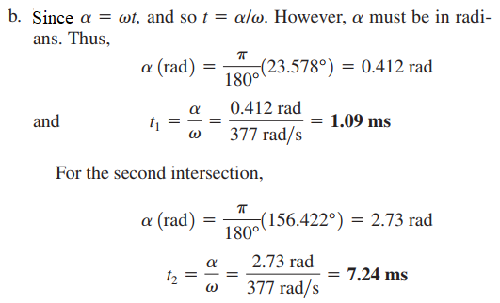
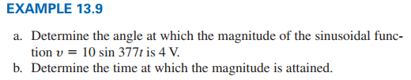
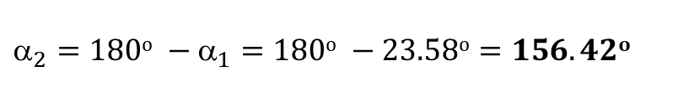
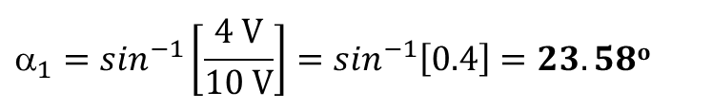
EXAMPLE 13.8 Given, e(t) = 5sinα V, determine e(t) at (a) α = 40º, (b) α = 0.8π, and (c) t = 13 ms if the angular frequency is 314 rad/s.
However, Fig.13.19 reveals that the magnitude of 4 V (positive) will be attained at two points between 0° and 180°. The second intersection is determined by
Solution: For α = 40º,
e(t) = 5sin(40º) = 5 ×(0.6428) = 3.21 V
For α = 0.8π = (180º/π)×(0.8π) = 144º
e(t) = 5sin(144º) = 5×(0.6428) = 3.21 V
For t = 13 ms and 314 rad/s,
α = ωt = (314)(13×10⁻³) rad.
= (314)×(13×10⁻³)×(180º/π) deg. = 234º
e(t) = 5sin(234º) = −4.05 V
$$_{2}=180o −_{1}=180o −23.58o=156.42o$$
Solution: (a) According to question we can write,
v(t) = 10sinα = 4 V
$$_{1}=\sin^{−1}\left[\frac{4 V}{10 V}\right]=\sin^{−1}\left[0.4\right]=23.58o$$
12

Slide 13
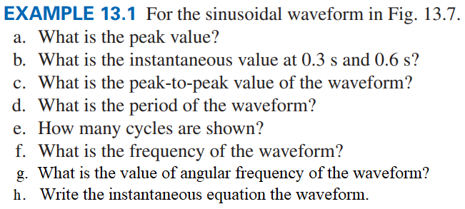
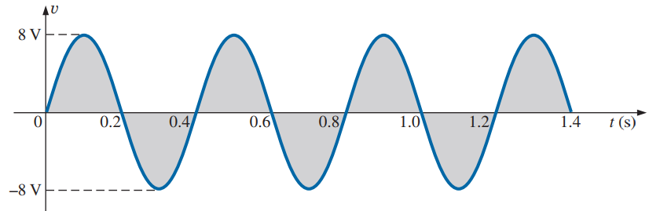
Solution:
(a) Peak Value: V_{m} = 8 V
(b) Instantaneous value at 0.3 s is −8V
Instantaneous value at 0.6 s is 0 V
(c) Peak-to-peak Value: V_{p-p} =2V_{m} = 16 V
(d) Period: T = 0.4 s
(e) Number of cycle: (1.4s/0.4s) = 3.5 cycles
(f) Frequency: f =1/T = 1/(0.4 s) = 2.5 Hz
(g) Angular Frequency: ω = 2πf = 15.7 rad/s
(h) Instantaneous Equation:
v(t) = 8Vsinα V = 8Vsin15.7t V
13

Slide 14
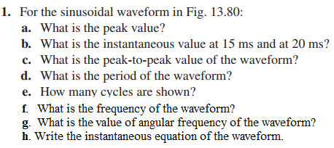
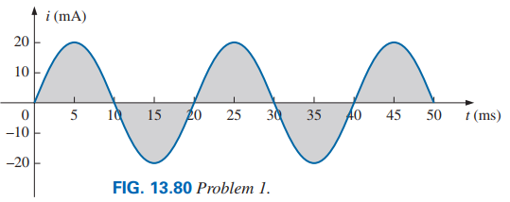
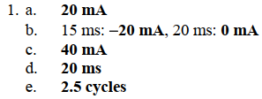
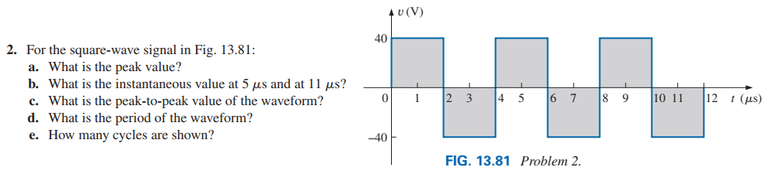
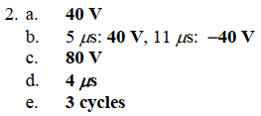
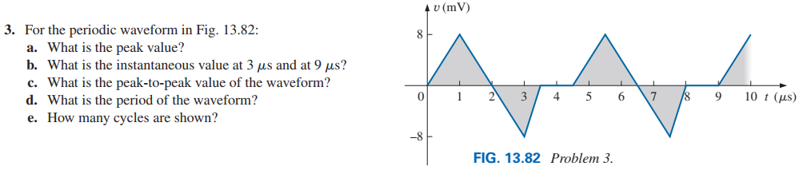
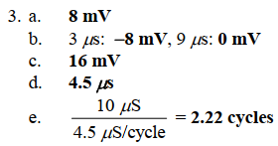
50 Hz
g. 314 rad/s
h. i(t) = 20mAsinα = 20mAsin314t
14

Slide 15
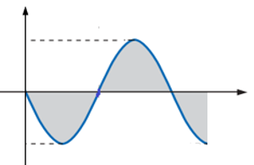
PROBLEM 18 [P582] Sketch i(t) = 5sin754t A with the abscissa: a. angle in degrees, b. angle in radians, and c. time in seconds.
PROBLEM 19 [P582] Sketch i(t) = −7.6sin43.6t A with the abscissa: a. angle in degrees, b. angle in radians, and c. time in seconds.
Solution: Here, I_{m} = 5 A, ω = 754 rad/s.
Solution: Here, I_{m} = 7.6 A, ω = 43.6 rad/s.
T = 2π/ω = 2π/754 = 8.33 ms
T = 2π/ω = 2π/43.6 = 144 ms
i(t) [A]
i(t) [A]
7.6
5
0 90º 180º 270º 360º 450º α [deg.]
0 90º 180º 270º 360º 450º α [deg.]
−7.6
−5
i(t) [A]
i(t) [A]
7.6
5
0 π/2 π 3π/2 2π 5π/2 α [rad.]
0 π/2 π 3π/2 2π 5π/2 α [rad.]
−7.6
−5
i(t) [A]
i(t) [A]
7.6
5
0 36 72 108 144 180 t [ms]
0 2.08 4.17 6.25 8.33 10.41 t [ms]
−7.6
−5
Practice Problem 17 ~ 24 [P582]
15

Slide 16
General Format of Mathematical Equation for the Sinusoidal
Voltage/Current with Phase Angle
16

Slide 17
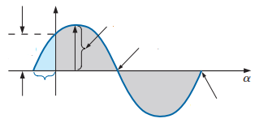
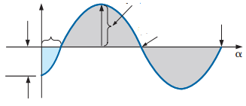
Mathematical Equation for the Sinusoidal when start Before or After 0°
If the waveform passes through the horizontal axis (y-axis) with a positive-going (increasing with time) slope before 0°, as shown in the following Figures, the expression is
e(t)=E_{m}sin(α+θ_{e}) V = E_{m}sin(ωt+θ_{e}) V
v(t)=V_{m}sin(α+θ_{v}) V = V_{m}sin(ωt+θ_{v}) V
i(t)=I_{m}sin(α+θ_{i}) V = I_{m}sin(ωt+θ_{i}) A
e(t)
E_{m}
v(t)
V_{m}
i(t)
I_{m}
E_{m}sinθ_{e}
(π−θ_{e})
V_{m}sinθ_{v}
(π−θ_{v})
I_{m}sinθ_{i}
(π−θ_{i})
θ_{e}
θ_{v}
θ_{i}
(2π−θ_{e})
(2π−θ_{v})
(2π−θ_{i})
If the waveform passes through the horizontal axis (y-axis) with a positive-going (increasing with time) slope after 0°, as shown in the following Figures, the expression is
e(t)=E_{m}sin(α−θ_{e}) V = E_{m}sin(ωt−θ_{e}) V
v(t)=V_{m}sin(α−θ_{v}) V = V_{m}sin(ωt−θ_{v}) V
i(t)=I_{m}sin(α−θ_{i}) V = I_{m}sin(ωt−θ_{i}) A
e(t)
E_{m}
(2π+θ_{e})
v(t)
V_{m}
(2π+θ_{v})
i(t)
I_{m}
(2π+θ_{i})
θ_{e}
(π+θ_{e})
θ_{v}
(π+θ_{v})
θ_{i}
(π+θ_{i})
−E_{m}sinθ_{e}
−V_{m}sinθ_{v}
−I_{m}sinθ_{i}
17

Slide 18
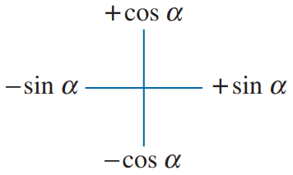
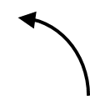

Phase Angle and Initial Angle
In generally, the instantaneous or time domain equation can be written as follows:
Remember: To identify the phase angle from an equation, at first +cos, − cos and − sin convert to +sin.
e(t) = E_{m}sin(α + θ_{e}) V = E_{m}sin(ωt + θ_{e}) V
v(t) = V_{m}sin(α + θ_{v}) V = V_{m}sin(ωt + θ_{v}) V
i(t) = I_{m}sin(α + θ_{i}) A = I_{m}sin(ωt + θ_{i}) A
If the waveform is given as cosα, −cosα, and −sinα must be convert to positive sine wave that means sinα using the following relations:
θ_{e}, θ_{v} and θ_{i} are called phase angle.
cosα = sin(α + 90º)
− cosα = sin(α − 90º)
− sinα = sin(α ± 180º)
Initial Angle: The angle from which a waveform started with a positive-going (increasing with time) slope is called initial angle.
Initial Angle = − Phase Angle
θ_{e0} = − θ_{e}; θ_{v0} = − θ_{v}; θ_{i0} = − θ_{i};
where, θ_{e0}, θ_{v0} and θ_{i0} are initial angle.
sin(α + 180º)
sin(α + 90º)
sin(α − 180º)
sin(α − 90º)
18

Slide 19
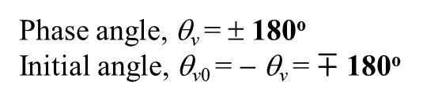
EXAMPLE Identify the phase angle and find the initial angle for the following waveforms:
(a) e(t) = 20sinωt V
(b) v(t) = 100cosωt V
v(t) = 100sin(ωt + 90º) V
Phase angle, θ_{e} = 0º
Initial angle, θ_{e0} = − θ_{e} = 0º
Phase angle, θ_{v} = 90º
Initial angle, θ_{v0} = − θ_{v} = − 90º
(c) i(t) = − 2cosωt A
(d) v(t) = − 150sinωt V
i(t) = 2sin(ωt − 90º) A
v(t) = 100sin(ωt ± 180º) V
Phase angle, θ_{i} = − 90º
Initial angle, θ_{i0} = − θ_{i} = 90º
Phase angle, θ_{v} = ± 180º
Initial angle, θ_{v0} = − θ_{v} = $∓$ 180º
(e) v(t) = 60cos(ωt − 20º) V
(f) e(t) = − 160cos(ωt − 20º) V
v(t) = 60sin(ωt − 20º + 90º) V = 60sin(ωt + 70º) V
e(t) = 160sin(ωt − 20º − 90º) V = 160sin(ωt − 110º) V
Phase angle, θ_{v} = 70º
Initial angle, θ_{v0} = − θ_{v} = − 70º
Phase angle, θ_{e} = − 110º
Initial angle, θ_{e0} = − θ_{e} = 110º
(g) i(t) = −8sin(ωt + 80º) A
i(t) = 8sin(ωt + 80º ± 180º) A
= 8sin(ωt + 260º) A
= 8sin(ωt − 100º) A
Phase angle or, θ_{i} = 260º or − 100º
Initial angle, θ_{i0} = − θ_{i} = − 260º or 100º
19

Slide 20
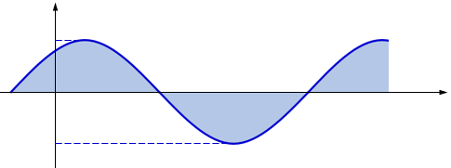





EXAMPLE Sketch v(t) = 50sin(261.67t + 60º) V with the abscissa:
a. angle in degrees, b. angle in radians, and c. time in seconds.
Solution: Here, V_{m} = 50 V, ω = 261.67 rad/s, θ_{v0} = − θ_{v} = − 60º
$T= \frac{2π}{\text{ω}}=\frac{2π}{\text{261.67}}=$ 24 ms
θ_{v0} (rad.) =$−\text{60}°×\frac{π}{180°}$= $−$1.05 rad
v(t) [V]
v(t) [V]
$$\frac{π}{\text{2}}=1.57 rad$$
50
50
−60º 150º 240º 330º 420º 510º α [deg.]
−1.05 2.62 4.19 5.76 7.33 8.9 α [rad.]
−50
−50
v(t) [V]
50
$t0= \frac{\text{θ}\text{v}\text{0}}{\text{ω}}×\frac{π}{180°}= \frac{−\text{60}°}{\text{261.67}}×\frac{π}{180°}=$ − 4 ms
−4 2 8 14 20 26 t[ms]
$\frac{T}{\text{4}}=$ 6 ms
−50
20

Slide 21
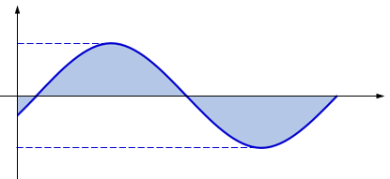





EXAMPLE Sketch e(t) = 80sin(157t − 30º) V with the abscissa:
a. angle in degrees, b. angle in radians, and c. time in seconds.
Solution: Here, E_{m} = 80 V, ω = 157 rad/s, θ_{e0} = − θ_{e} = 30º
$T= \frac{2π}{\text{ω}}=\frac{2π}{\text{15}\text{7}}=$ 40 ms
θ_{e0} (rad.) =$\text{3}\text{0}°×\frac{π}{180°}$= 0.52 rad
e(t) [V]
e(t) [V]
80
80
$$\frac{π}{\text{2}}=1.57 rad$$
30º 120º 210º 300º 390º α [deg.]
0.52 2.09 3.66 5.23 6.8 α [rad.]
−80
−80
e(t) [V]
80
$t0= \frac{\text{θ}\text{e}\text{0}}{\text{ω}}×\frac{π}{180°}= \frac{\text{3}\text{0}°}{\text{15}\text{7}}×\frac{π}{180°}=$ 3.33 ms
3.33 10.33 20.33 30.33 40.33 t[ms]
$\frac{T}{\text{4}}=$ 10 ms
−80
Practice Problem 25 ~ 26 [P582]
21

Slide 22
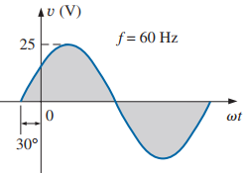
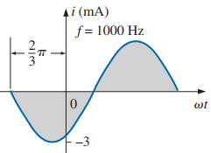






PROBLEM 27 and 28 [P583] Write the analytical expression for the waveforms in Fig. 13.84 with the phase angle in degrees.
V_{m} = 25 V
I_{m} = 3 mA
ω = 2π×60 ≈ 377 rad/s
ω = 2π×1000 ≈ 6280 rad/s
θ_{e} = − θ_{e0} = −(− 30º) = 30º
θ_{i} = − θ_{i0} = −(− $\frac{2π}{3}$) = $\frac{2π}{3}$
θ_{i} = $\frac{2π}{3} ×\frac{180°}{π}$= $120°$
v(t) = 25sin(377t + 30º) V
i(t) = − 3sin(6280t + 120º) mA
I_{m} = 2 mA
V_{m} = 0.01 V
ω = 2π×10000 ≈ 62800 rad/s
ω = 2π×40 ≈ 251.2 rad/s
θ_{i} = − θ_{i0} = −(− $\frac{3π}{4}$) = $\frac{3π}{4}$
θ_{e} = − θ_{e0} = −(100º) = − 100º
θ_{i} = $\frac{3π}{4} ×\frac{180°}{π}$= $135°$
i(t) = 2sin(62800t + 135º) mA
v(t) = 0.01sin(251.2t − 100º) V
22

Slide 23
Phase Difference and Phase Relation Between Two Waveforms
23

Slide 24



Phase Difference and Phase Relation Between Two Waveforms
Case II:
Angle Difference= Voltage angle − Current Angle > 0º
Phase Relation: v(t) leads i(t), or i(t) lags v(t)
v(t) starts before i(t), or i(t) starts after v(t)
Conditions to find the Phase difference, Time difference and phase relation between two waveforms:
They must be same type waveforms
Their frequency or angular frequency or time period must be same
Angle Difference = Voltage angle − Current Angle
Phase Difference = ⏐ Angle Difference ⏐
Case I:
Angle Difference= Voltage angle − Current Angle = 0º
Phase Relation: v(t) and i(t) are in phse.
The starting points of v(t) and i(t) are same.
Case III:
Angle Difference= Voltage angle − Current Angle < 0º
Phase Relation: v(t) lags i(t), or i(t) leads v(t)
v(t) starts after i(t), or i(t) starts before v(t)
24

Slide 25


EXAMPLE 13.12 (a) What is (i) the phase difference, and (ii) the phase relationship between the sinusoidal waveforms of the following sets? (a) v(t) = 10sin(ωt + 30°) V; i(t) = 5sin(ωt + 70°) A
Solution: (i) Angle Difference = (+30°) − (+70°) = − 40°
Phase Difference = ⏐− 40°⏐ = 40°
(ii) Angle Difference < 0°; So,
v(t) lags i(t) by 40º, or i(t) leads v(t) by 40º
It is seen from Fig. 13.31 that v(t) starts before i(t) thus:
v(t) lags i(t) by 40º, or i(t) leads v(t) by 40º
EXAMPLE 13.12 (b) What is (i) the phase difference, and (ii) the phase relationship between the sinusoidal waveforms of the following sets? (b) i(t) = −15cos(ωt + 150°) A; v(t) = 10sin(ωt − 20°) V
Solution: i(t) = − 15cos(ωt + 150°) A = 15sin(ωt + 150° − 90°) A = 15sin(ωt + 60°) A
(i) Angle Difference = (−20°) − (+60°) = − 80°
Phase Difference = ⏐− 80°⏐ = 80°
(ii) Angle Difference < 0°; So,
v(t) lags i(t) by 80º, or i(t) leads v(t) by 80º
It is seen from Fig. 13.32 that v(t) starts before i(t) thus:
v(t) lags i(t) by 80º, or i(t) leads v(t) by 80º
25

Slide 26

EXAMPLE 13.12 (e) What is (i) the phase difference, and (ii) the phase relationship between the sinusoidal waveforms of the following sets? (e) v(t) = 2sin(ωt + 10°) V; i(t) = − sin(ωt + 30°) A
Solution:
i(t) = − sin(ωt + 30°) A = sin(ωt + 30° − 180°) A = sin(ωt − 150°) A
(i) Angle Difference = (10°) − (− 100°) = 160°
Phase Difference = ⏐− 160°⏐ = 160°
(ii) Angle Difference > 0°; So,
v(t) leads i(t) by 160º, or i(t) lags v(t) by 160º
It is seen from Fig. 13.33 that v(t) starts before i(t) thus:
v(t) lags i(t) by 110º, or i(t) leads v(t) by 110º
Another Answer: i(t) = − sin(ωt + 30°) A = sin(ωt + 30° + 180°) A = sin(ωt + 210°) A
(i) Angle Difference = (10°) − (+210°) = − 200°
Phase Difference = ⏐− 200°⏐ = 200°
Practice Problem 29 ~ 33 [P583]
(ii) Angle Difference < 0°; So,
v(t) lags i(t) by 200º, or i(t) leads v(t) by 200º
26

